Slide 1

19AIE205 – Python for Machine Learning
PREDICTION OF STUDENTS PERFORMANCE USING LINEAR REGRESSION

Slide 2
Group 4: Members
AM.EN.U4AIE20102 - Abhijith A Thampi
AM.EN.U4AIE20107 - Adwaith Krishna E R
AM.EN.U4AIE20108 - Ajay G Nair
AM.EN.U4AIE20173 - Vivin

Slide 3
INTRODUCTION
Analyzing and predicting academic performance of students is important for any educational institutions
Predicting students' performance can help teachers develop a strategy to facilitate the growth
We used the concept of Linear Regression to predict the performance of the students
Linear regression considers input as students current marks and predicts their future scores

Slide 4
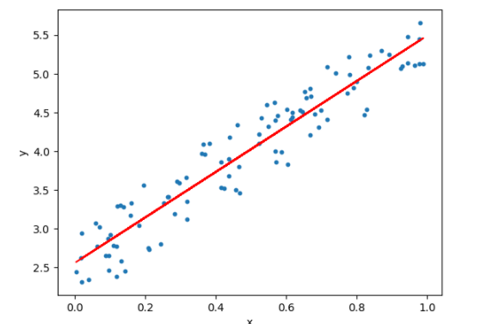
Linear Regression
Linear Regression is a supervised learning ML algorithm to perform regression task.
It assumes linear relationship between input variable x and single output variable y.
One variable , denoted x is regarded as the predictor, explanatory or independent variable
Other variable, denoted y is regarded as the response, outcome or dependent variable
We used Linear Regression to calculate the R² score, mean squared & mean absolute error to measure the accuracy of our training model.

Slide 5
Label encoding
In Machine Learning, Label encoding refers to converting the labels into a numeric form to convert them into the machine-readable form.
ML algorithms can then decide in a better way how those lables must be operated.
The chosen training dataset contains multiple labels in the form of strings.
So, in our dataset, it is important to pre-process the training dataset.

Slide 6
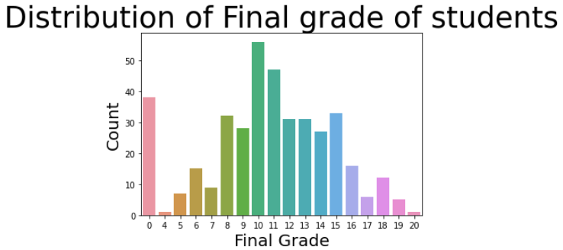
IMPLEMENTATION
We implemented the distribution of final grade of students from the given dataset.
Various bar graphs has been implemented using the training dataset.
Data set is pre-processed, and features and labels are extracted from dataset
Then dataset is split in to test and train sets
Linear regression is applied to dataset for prediction.
https://github.com/ft-abhx/ML_Project/blob/main/ML_END_SEM_PROJECT.ipynb

Slide 7
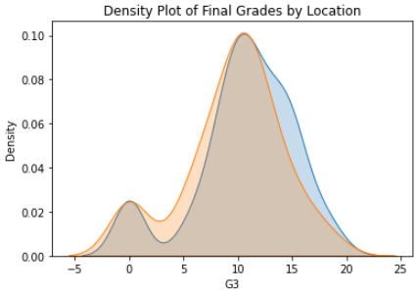
OBSERVATIONS
Explored the training data to find interesting patterns, trends, or anomalies
Examined correlations between the features and the target
Established a baseline and benchmarked machine learning models
Classification model achieves 79.85% accuracy
Before final marks of all subjects are evaluated prediction can be performed

Slide 8
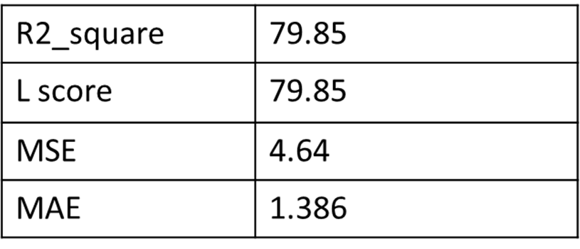
Conclusion / Result
R² Score: R² score is used to evaluate the performance of a linear regression model. It is the amount of the variation in the output dependent attribute which is predictable from the input independent variable.
It can be referred that 79.85% of the changeability of the dependent output attribute can be explained by the model while the remaining 20.15% of the variability is still unaccounted for.
Mean absolute error (MAE): is defined as quantity used to measure how close predictions or forecasts are to the eventual outcomes.
Root mean square error (RMSE): is defined as frequently used measure of the differences between values predicted by a model or an estimator and the values actual observed.

Slide 9

References
https://towardsdatascience.com/bayesian-linear-regression-in-python-using-machine-learning-to-predict-student-grades-part-1-7d0ad817fca5
https://www.kaggle.com/aljarah/xAPI-Edu-Data
https://archive.ics.uci.edu/ml/datasets/student+performance#
https://towardsdatascience.com/introduction-to-machine-learning-algorithms-linear-regression-14c4e325882a

